Slide 1
Annual Members vs Casual Riders
Presented by: Carlos Reyes
Last updated: December 2023

Slide 2





Table of Contents
Background
Business Task
Analysis
Key Findings
Recommendations

Slide 3
Background
Story behind the project

Slide 4
Background
Cyclistic’s finance analysts have concluded that annual members are much more profitable than casual riders.
This presents a solid opportunity to convert casual riders into annual members.

Slide 5
Business Task
Our team’s goal

Slide 6
Business Task
Design marketing strategies aimed at converting casual riders into annual members.

Slide 7
Analysis
How do annual members and casual riders use Cyclistic bikes differently?

Slide 8
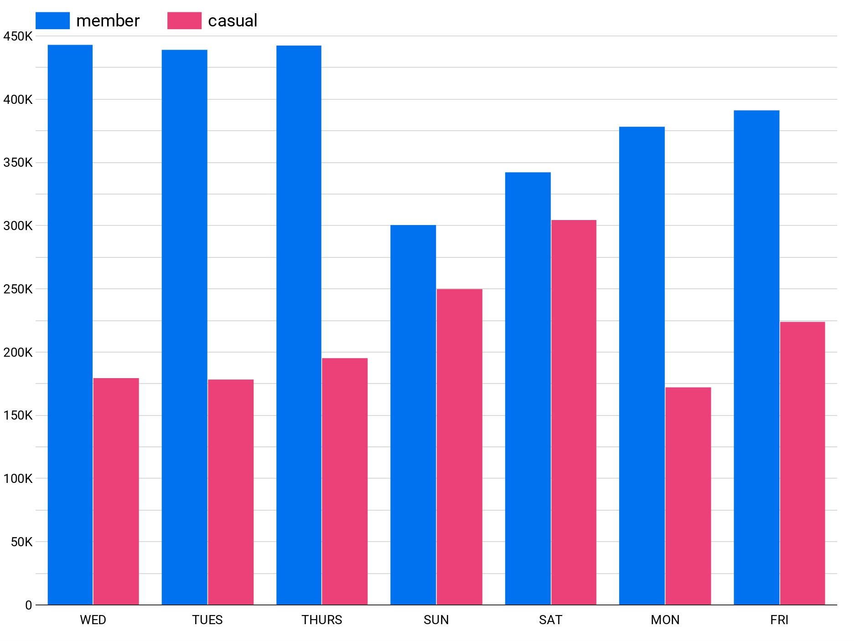
Number of Rides (Days of the Week)
Wednesdays and Thursdays register the highest number of rides for annual members.
For casual riders, Saturdays and Sundays register the highest number of rides.
Casual riders prefer the weekends to go for a bicycle ride.

Slide 9
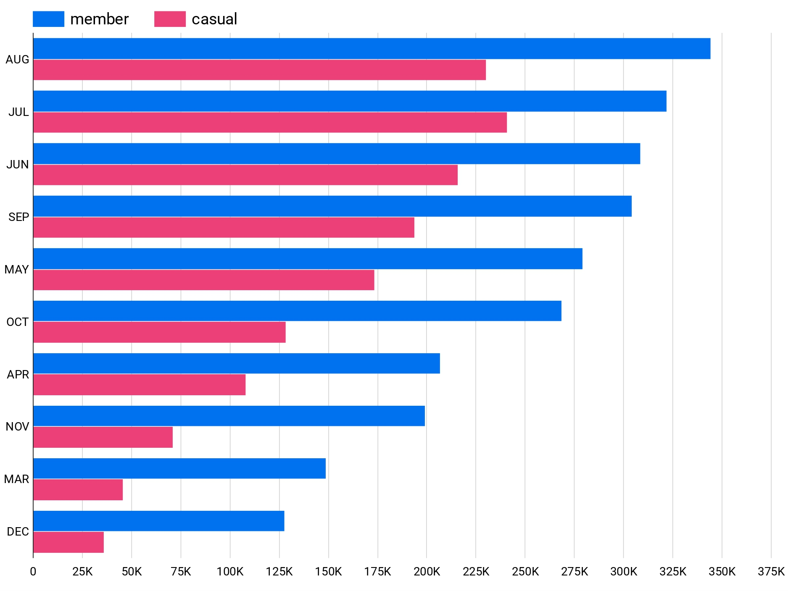
Number of Rides (Months)
For anual members, August registers the most rides.
For casual riders, July registers the most rides.
Both types of riders are more active during the summer.

Slide 10
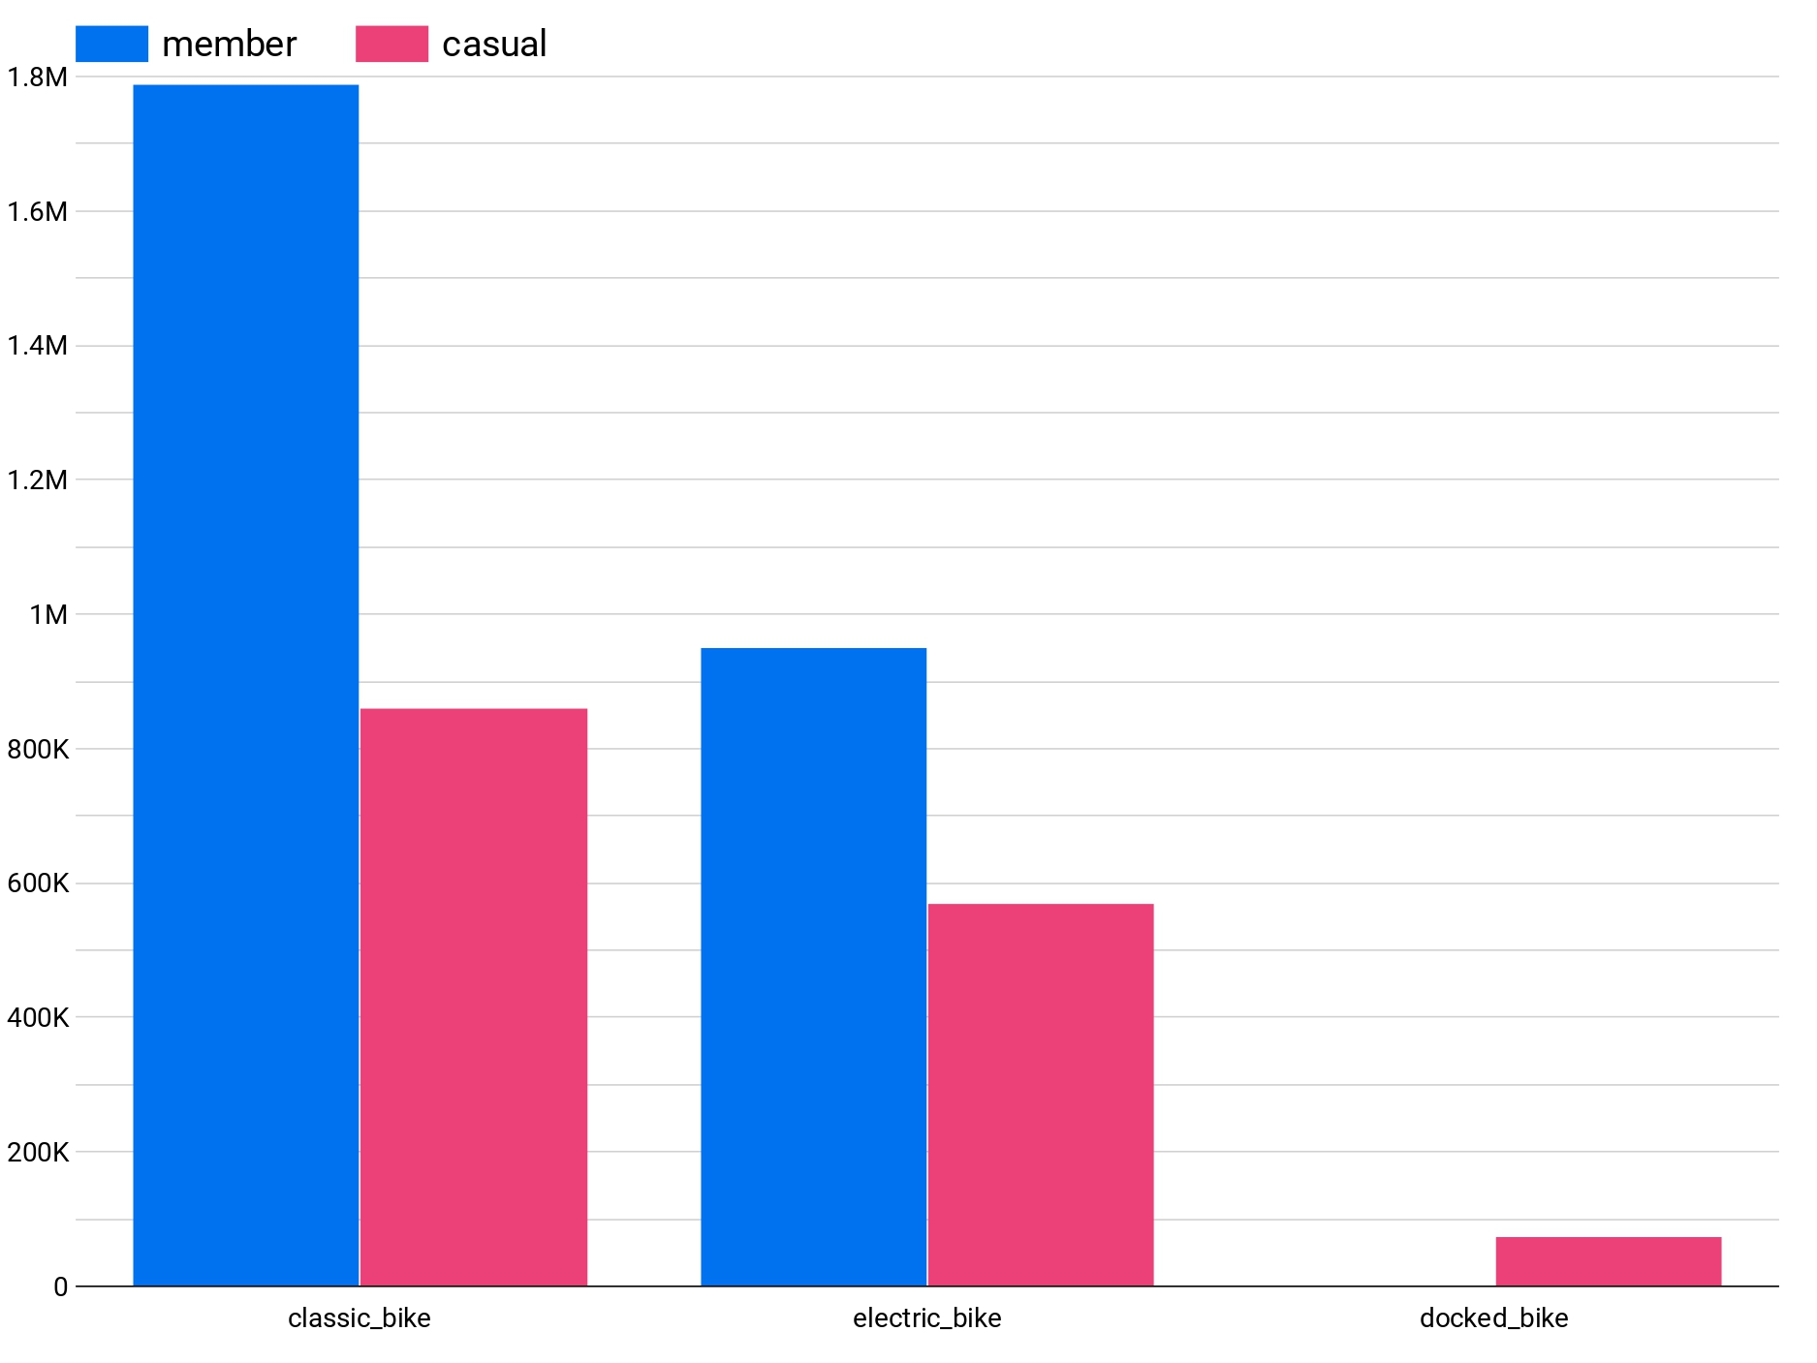
Bike Usage
Both types of riders use classic bikes the most.
Only casual riders used docked bikes.

Slide 11
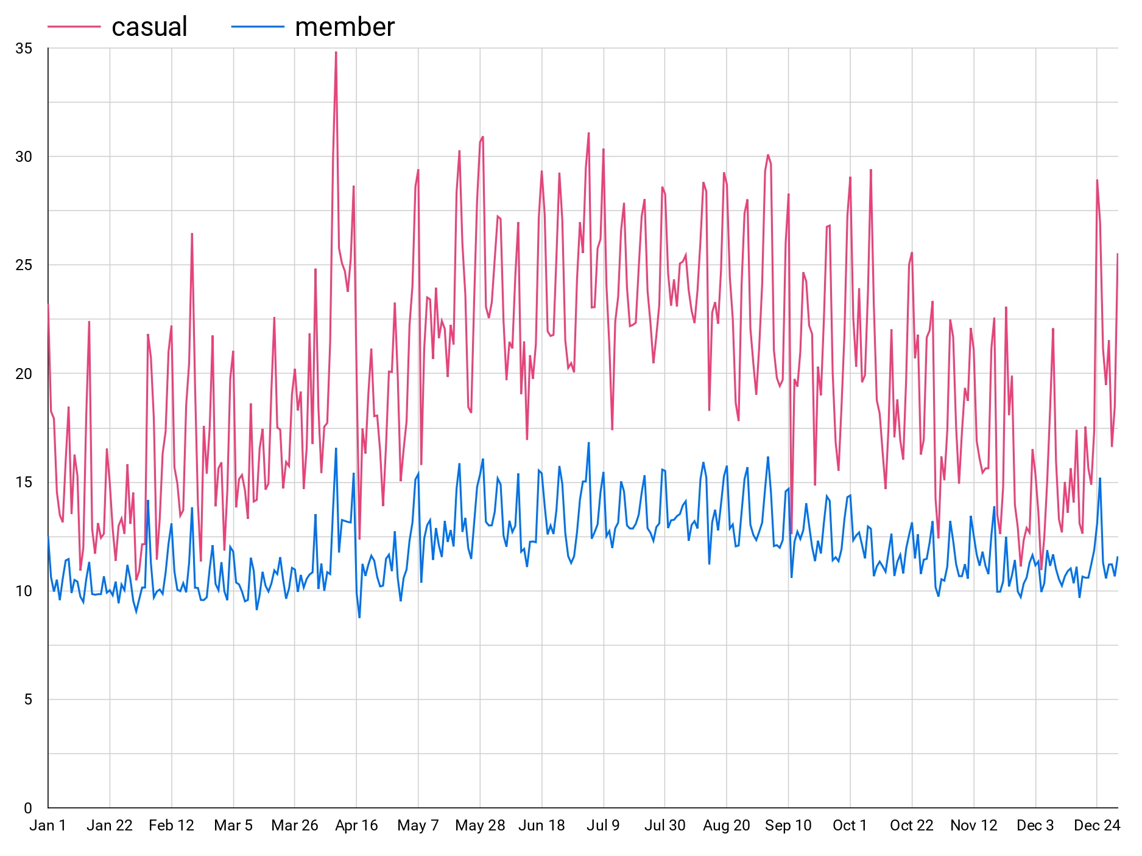
Average Trip Duration
Casual riders tend to have longer bike trips than annual members

Slide 12
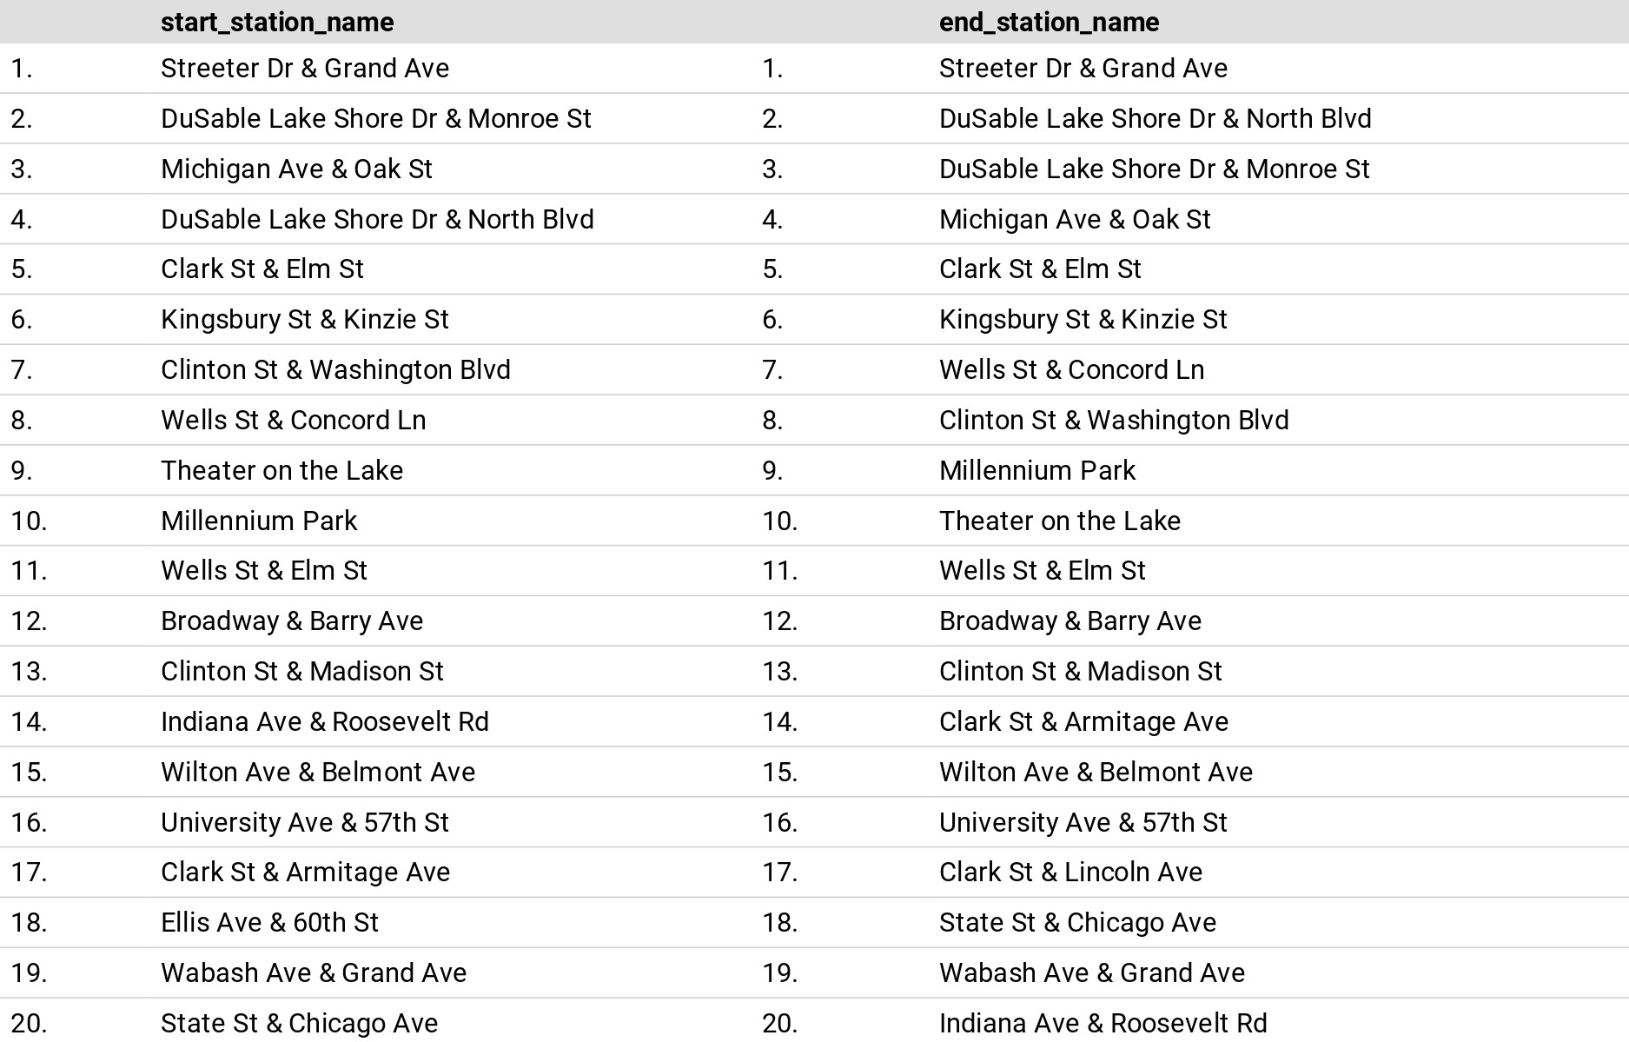
Most Used Stations
Streeter Dr & Grand Ave, DuSable Lake Shore Dr & Monroe St, Michigan Ave & Oak St, and Clark St & Elm St are within the top 5 of both lists.

Slide 13
Key Findings
What is the data telling us?

Slide 14
Key Findings
Casual riders prefer to take bike trips during the weekends.
Casual riders take longer bike trips than annual members.
Only casual riders have preference for docked bikes.
Summer months are when bike users ride the most.

Slide 15
Recommendations
Based on the data

Slide 16



Recommendations
Launch the marketing campaign during summer along with an event at the top 20 most used stations where riders can participate in different activities.
Offer discounts for new annual members and a different benefit for existing members
Develop and launch an app in which annual members can view their stats and also any nearby station.

Slide 17
Thank you for your attention

